Slide 1
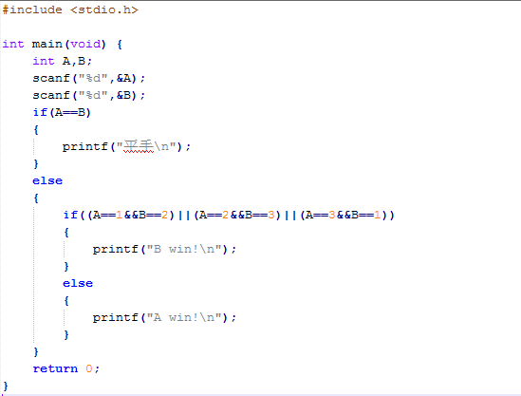
練習2.2參考code

Slide 2
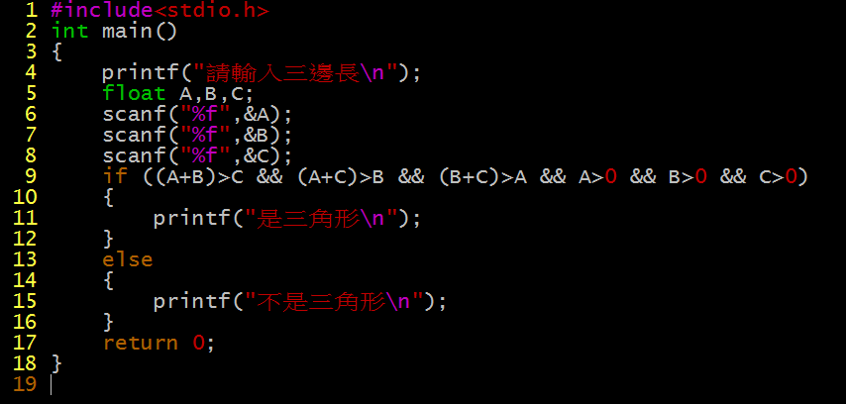
練習2.3參考code

Slide 3
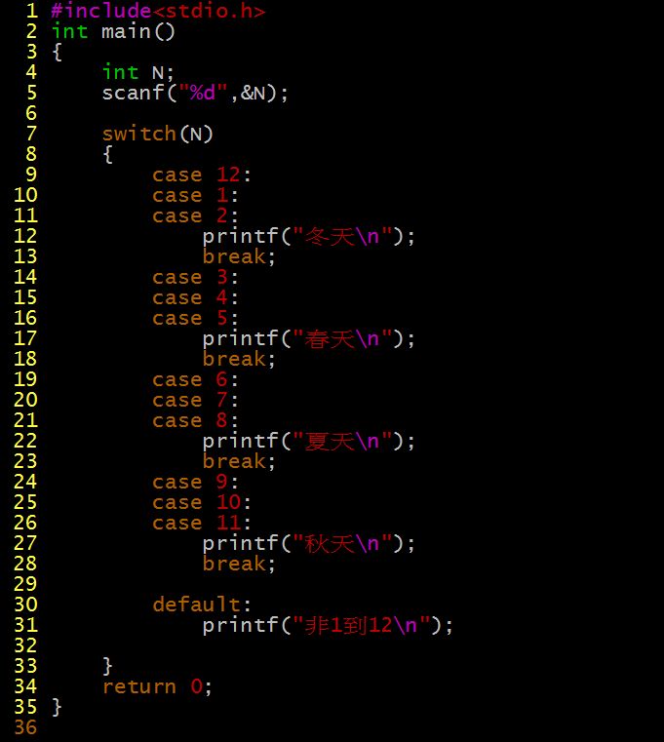
練習3.3參考code

